Slide 1
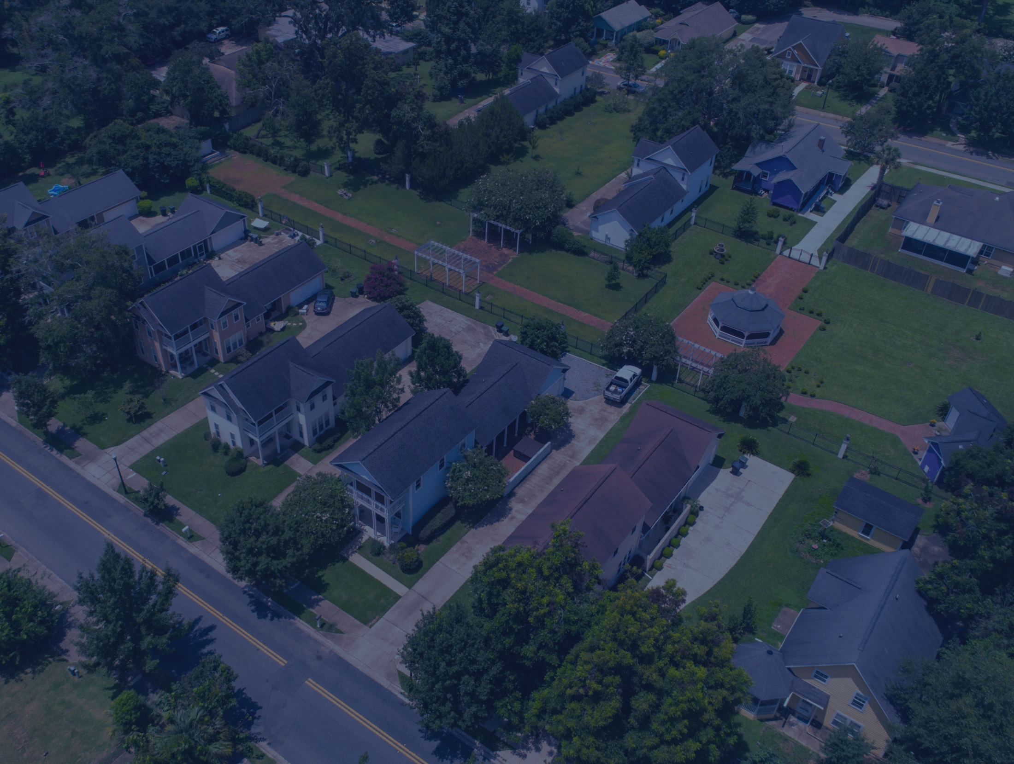

Policies to Increase Affordable Housing - Local Perspective
City of Tallahassee
February 2026
NCDA Winter Legislative Conference
DEPARTMENT OF HOUSING AND COMMUNITY RESILIENCE

Slide 2
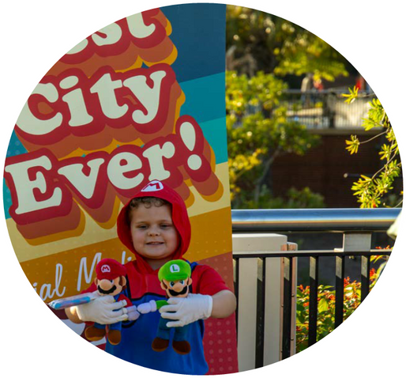
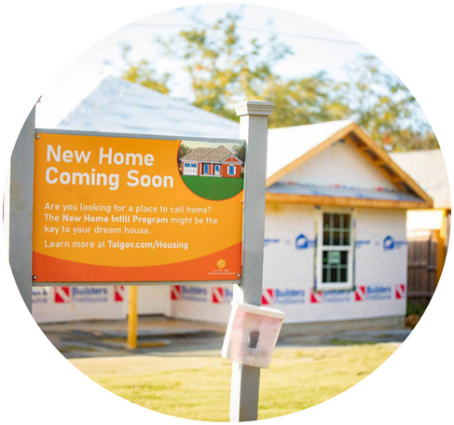


Housing and Community Resilience
WHO WE ARE
WHAT WE DO
HOW WE DO IT
The City of Tallahassee is a partner in creating housing opportunities, encouraging new unit development, and broadening the availability of safe and healthy housing.
The City administers programs funded with CDBG and HOME, along with local and state dollars to increase and preserve the inventory of safe, healthy, and quality housing for any income level, providing safe spaces for vulnerable residents.
Our diverse programs and partnerships allow us to administer over $5M in grants and local funds annually, providing unique opportunities for creative and sustainable affordable housing solutions.

Slide 3
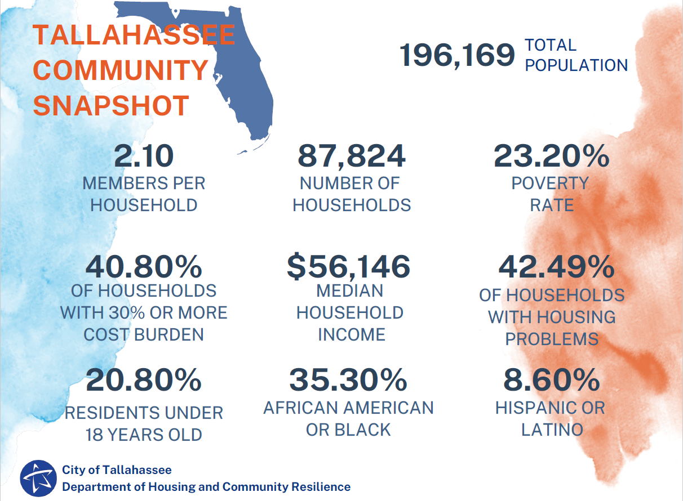
OUR COMMUNITY

Slide 4
NOTE:
Coordination and collaboration between the Planning and Housing departments is key to advancing innovative affordable housing policy.
INNOVATIVE INCENTIVES…
Land Use & Zoning Tools
- Smaller lots, duplexes, ADU’s and other zoning flexibilities
Inclusionary housing ordinance with affordability requirements
Land use waivers (Live Local, YIGBY) allowing for flexibility in placement, zoning, density, height, and other restrictions that increase the cost of construction
NRSA’s and land trusts
Financial Tools
Subsidy via federal and state funding, local trust funds, and TIF districts
Public lands suitable for affordable housing are made first available via donation to affordable housing partners (Land Trust, Habitat, CHDO)
Fee waivers or reductions for affordable housing
Capacity Building
Technical assistance through the City’s DesignWorks studio on planning, lot placement, zoning, land use, etc.
Technical assistance on all federal cross-cutting requirements
Expedited permitting and expert help navigating the development process

Slide 5
…SUPPORT INNOVATIVE PROGRAMS
Housing Development/Preservation Programs
Inclusionary housing
Community Housing Development Organizations
Affordable Housing Construction Loan Program
Habitat for Humanity
Community Land Trust
Multifamily Development Program
Rental/Homeowner Rehabilitation Programs
Land Use/Planning and Resources
Infill development
Property escheatment
Subsidy
Purchase Assistance
Waivers
Permitting and zoning flexibilities
CLT’s should be situated to qualify as a CHDO making them eligible for federal HOME funding from an LG, providing a proven pathway for LG’s to expend HOME funds on this required set-aside.

Slide 6
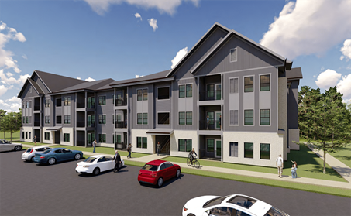
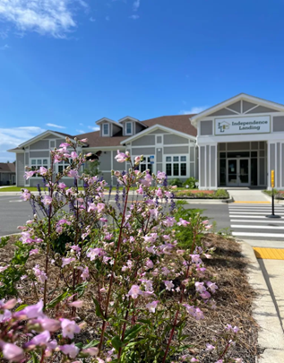
…producing new affordable units
MULTIFAMILY/RENTAL DEVELOPMENT*
General Stage of Development | Number of Multi-Family Units
In Planning Stage | 425
In Permitting Stage | 145
Under Construction | 465
Current Pipeline Total | 1,035
Number of Units Completed | 1,913
Current Unit Total | 2,948
*Since 2020; data reported as of September 2025

Slide 7
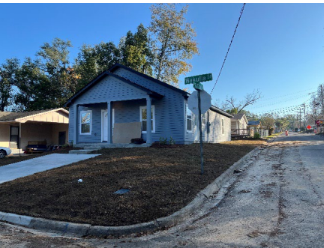
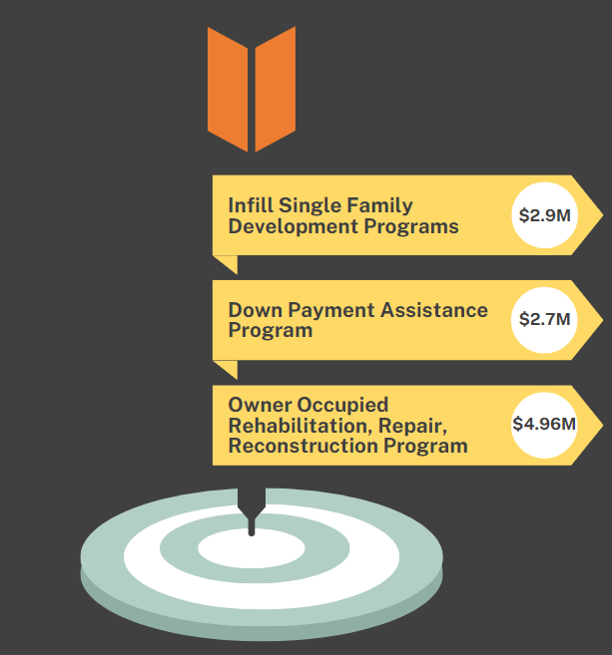
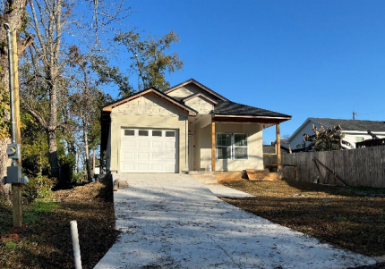
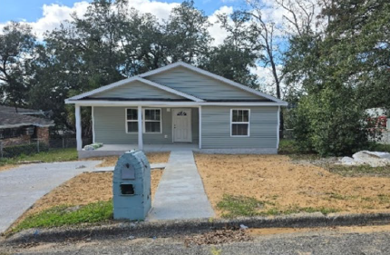
…producing new affordable units
SINGLE FAMILY HOMEOWNERSHIP DEVELOPMENT
52 units constructed
45 units sold (average sales price $175K to $225K)
140 Loans
$19,500 average per loan
574 units rehabbed/rebuilt
$8,600 average per unit

Slide 8
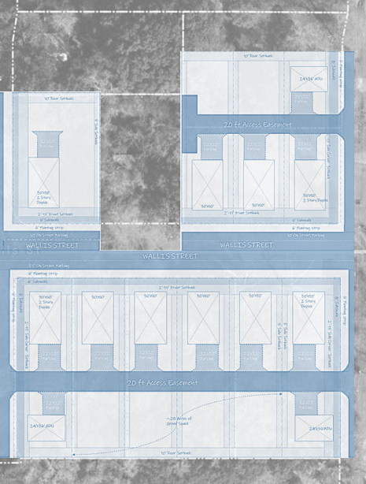
IN ACTION – WALLIS STREET PROJECT
The Wallis Street project aims to offer affordable housing solutions in the vibrant heart of Tallahassee’s South City. This initiative focuses on creating a single-family pocket neighborhood catering to the "missing middle" demographic.
Up to 24 units, including 1-, 2-, and 3-bedroom units and accessory dwelling units.
Public-Private Partnership with CRA, County, City and CLT will include benefits such as:
Fee Waivers
Reduction/Modification of land use requirements
City CDBG/HOME Funding
DPA for buyers
Surplus land donation
Private Equity
County SHIP Funding
CRA Funding

Slide 9
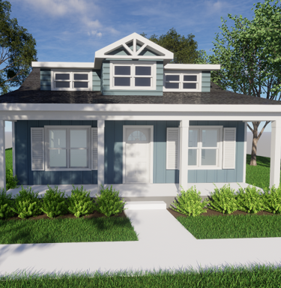
IN ACTION – WALLIS STREET PROJECT
2010 - City of Tallahassee used Neighborhood Stabilization Program funds to purchase multiple lots on one street
2022 - Lots donated to the CLT
2023 - Planning began
2024 – CDBG funds used for engineering, planning, architect
2025 – CLT awarded funds to begin infrastructure construction
Once complete, will include green space for residents
Situated 2 blocks from new South City Transit Center and new Southside City Park
THE
WAKULLA

Slide 10

KEY TAKE AWAYS
It is important for LG staff to understand the basics of the development process as they help influence policy at the local level.
Packaging programs with incentives like inclusionary policies, density bonuses, fee waivers, and other land use flexibilities for affordable housing is key for LG’s to have maximum impact on new development with minimal direct fiscal investment.
Solid partnerships with developers, nonprofits such as CHDO’s, and your local planning/growth management departments can result in pairing public funds with private investment for successful projects.

Slide 11
Thank you
Jean Amison, HCR Manager, City of Tallahassee
DEPARTMENT OF HOUSING AND COMMUNITY RESILIENCE
Website: www.talgov.com/housing
Email: jean.amison@talgov.com

